Slide 1
Game Theory Primer
Prisoner’s dilemma
Dominated strategies / dominant strategies
Payoff Matrix
Nash equilibrium
Coordination game

Slide 2
The Prisoner’s Dilemma
Two accomplices interrogated separately
The prosecutors
have enough evidence to sentence each one 1 year
do not have enough evidence to sentence 2 years unless at least one suspect confesses
If both confess, each sentenced 2 years
If neither confesses, each sentenced 1 year
If only one confesses, the confessor is immediately released, and the denier sentenced 3 years
No further interaction between the two accomplices after verdict
How should each criminal do?

Slide 3
The Prisoner’s Dilemma
 | Confess | Deny
Confess | (-2, -2) | (0, -3)
Deny | (-3, 0) | (-1, -1)
Individually optimal outcome <> socially optimal outcome

Slide 4
The Partnership Game
Two partners work in a joint venture:
Choose to either Effort/Shirk
Effort cost 3
Shirk cost 0
Revenue:
Both effort: 10
One effort: 6
Both shirk: 2
 | Shirk | Effort
Shirk | (1, 1) | (3, 0)
Effort | (0, 3) | (2, 2)
Individually optimal outcome <> socially optimal outcome

Slide 5
Prisoner’s New Dilemma
 | Confess | Deny
Confess | (-2, -2) | (-1, -3)
Deny | (-3, -1) | (0, 0)

Slide 6
The Nash Equilibrium
 | Confess | Deny
Confess | (-2, -2) | (-1, -3)
Deny | (-3, -1) | (0, 0)
Individually optimal outcome <> socially optimal outcome

Slide 7
Secure Strategy
 | Confess | Deny
Confess | (-2, -2) | (-1, -3)
Deny | (-3, -1) | (0, 0)
Individually optimal outcome <> socially optimal outcome

Slide 8
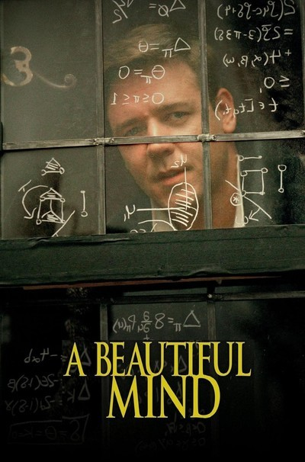
https://www.youtube.com/watch?v=CemLiSI5ox8

Slide 9
The beautiful mind game
 | Blond | Blond’s friend
Blond | (0,0) | (2,1)
Blond’s friend | (1,2) | (1,1)
Individually optimal outcome <> socially optimal outcome

Slide 10
Coordination Game
Alice and Bob wish to see each other at a party
If Bob goes, Alice would like to go too
If Bob does not go, Alice would not go either
Same for Bob
If Alice goes, Bob would like to go too
If Alice does not go, Bob would not go either
They don’t have each other’s contact info ☹
Should Alice and Bob go to the party or not?

Slide 11
Coordination Game
Bob
 | go | Not go
Go | (1, 1) | (-1, 0)
Not go | (0, -1) | (0, 0)
Alice
Dominant strategies? Nash equilibrium?

Slide 12
Coordination Game
Bob
 | go | Not go
Go | (1, 1) | (-1, 0)
Not go | (0, -1) | (0, 0)
Alice
Individually optimal outcome is not necessarily socially optimal outcome
How can we ensure Alice and Bob meet?
Digital Tokens and Platform Building

Slide 13
Game Theory Framework
Game theory is a general framework to aid decision making when agents’ payoffs depends on the actions taken by other players.
Games consist of the following components:
Players or agents who make decisions.
Planned actions of players, called strategies.
Payoff of players under different strategy scenarios.
A description of the order of play.
A description of the frequency of play or interaction.

Slide 14
Order of Decisions in Games
Simultaneous-move game
Game in which each player makes decisions without the knowledge of the other players’ decisions.
Sequential-move game
Game in which one player makes a move after observing the other player’s move.

Slide 15
Frequency of Interaction in Games
Overview of Games and Strategic Thinking
One-shot game
Game in which players interact to make decisions only once.
Repeated game
Game in which the same players interact to make decisions more than once.

Slide 16
One-Shot Games: Theory
Strategy
A decision rule that describes the actions a player will take at each decision point.
Normal-form game
A representation of a game indicating the players, their possible strategies, and the payoffs resulting from alternative strategies.

Slide 17
Possible Strategies
Dominant strategy
A strategy that results in the highest payoff to a player regardless of the opponent’s action.
Secure strategy
A strategy that guarantees the highest payoff given the worst possible scenario.
Nash equilibrium strategy
A condition describing a set of strategies in which no player can improve her payoff by unilaterally changing her own strategy, given the other players’ strategies.

Slide 18
Game tree; Multistage Games

Slide 19
Sequential-Move Game in Extensive Form
Alice’s payoff
Bob’s payoff
$$(1,1)$$
Decision node for Alice
denoting the beginning
of the game
Go
B
Go
Not go
$$(−1,0)$$
A
$$(0,−1)$$
Not go
Go
Alice’s feasible strategies:
B
Go
Not go
Not go
Bob’s decision nodes
Bob’s feasible strategies:
$$(0,0)$$
Go, if Alice plays Go and Not, if Alice plays Not
Not, if Alice plays Go and Not, if Alice plays Not
Go, if Alice plays Go and Go, if Alice plays Not
Not, if Alice plays Go and Go, if Alice plays Not

Slide 20
Multistage Games
Multistage games differ from the previously examined games by examining the timing of decisions in games.
Players make sequential, rather than simultaneous, decisions.
Represented by an extensive-form game.
Extensive form game
A representation of a game that summarizes the players, the information available to them at each stage, the strategies available to them, the sequence of moves, and the payoffs resulting from alternative strategies.

Slide 21
Subgame Perfect Equilibrium
Multistage Games
A condition describing a set of strategies that constitutes a Nash equilibrium and allows no player to improve his own payoff at any stage of the game by changing strategies.

Slide 22
Game of incomplete information
Bayesian Nash equilibrium

Slide 23
Infinitely Repeated Games
Tend to support more equilibrium payoffs
For stage games with multiple equilibria, sometimes finitely repeated games may also support more equilibrium payoffs

Slide 24
Mechanism design
“Reverse game theory”
Example, residents of a community are polled to decide whether to build a new community center
Wild thoughts: How many stop signs to elect at crossroads? https://papers.ssrn.com/sol3/papers.cfm?abstract_id=4197885

Slide 25
https://papers.ssrn.com/sol3/papers.cfm?abstract_id=4197885

